Slide 1





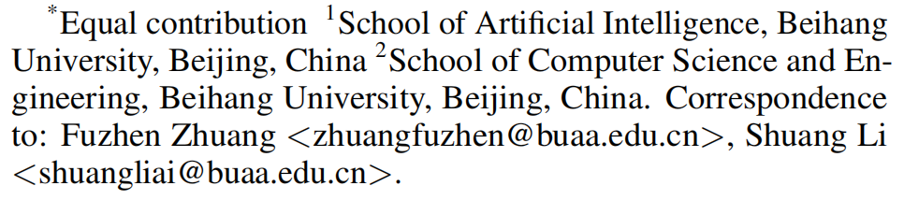





ATAI
Advanced Techniqueof Artificial Intelligence
ATAI
ChongqingUniversity _{AdvancedTechniqueof}
of Technology Artificial Intelligence
Chongqing University of
Technology
Chongqing University ^{ATAI}
_{of Technology} Advanced Techniqueof
Artificial Intelligence
Chongqing University of Technology
Chongqing University of Technology
SynGR：Cross-Modal Synergy for Generative Recommendation
Code: https://github.com/gxingyu/SynGR
—— ICML_2026
Reported by Yang Hu
1

Slide 2

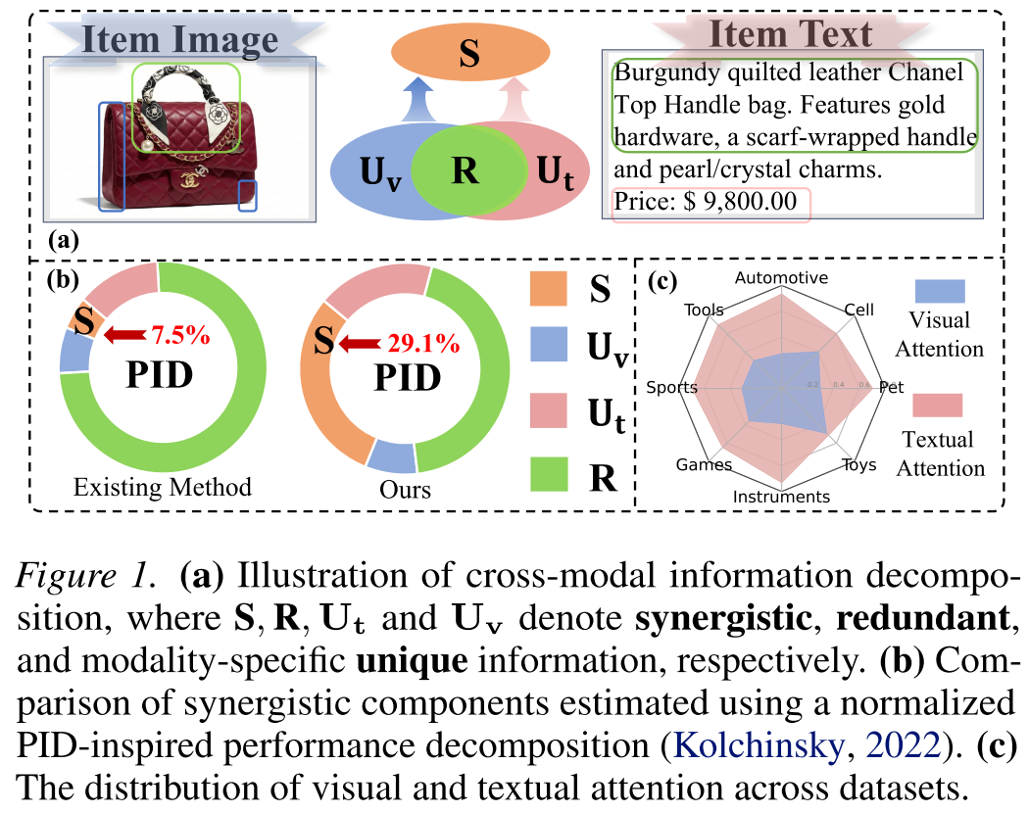
ATAI
AdvancedTechniqueof
Artificial Intelligence
ATAI
ChongqingUniversity _{AdvancedTechniqueof}
of Technology Artificial Intelligence
ChongqingUniversity of Technology
Motivation
1.Existing approaches largely rely on alignment centric fusion and underexplore synergistic information across modalities.
2.The current GR model assigns disproportionately higher attention weights to the textual modality, biasing learning toward text-dominant representations during next-token prediction.

Slide 3

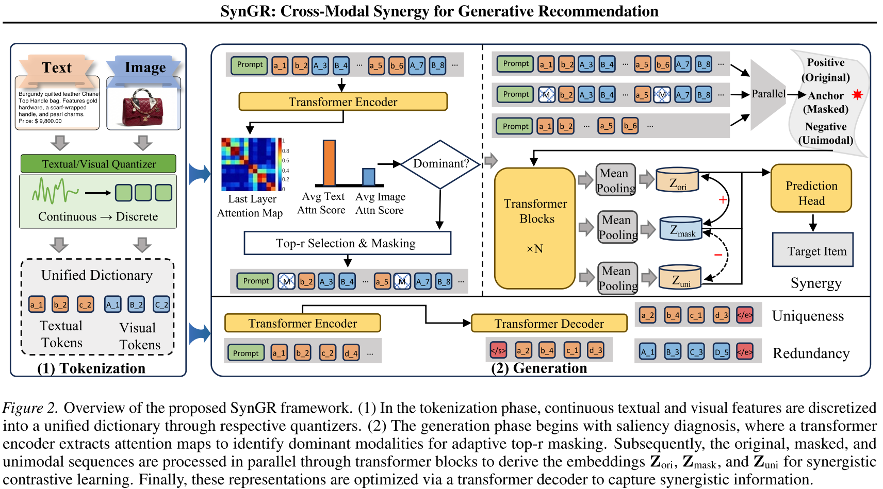
ChongqingUniversity of Technology
ATAI
AdvancedTechniqueof
Artificial Intelligence
ATAI
ChongqingUniversity _{AdvancedTechniqueof}
of Technology Artificial Intelligence
Overview

Slide 4
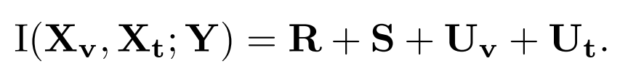
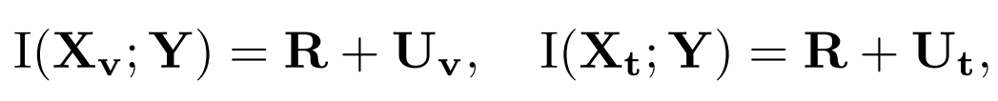

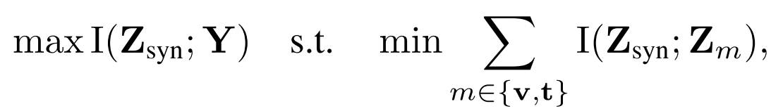
ChongqingUniversity of Technology
ATAI
AdvancedTechniqueof
Artificial Intelligence
ATAI
ChongqingUniversity _{AdvancedTechniqueof}
of Technology Artificial Intelligence
Method
(1)
(2)
(3)
(4)
(5)
(6)
(7)

Slide 5
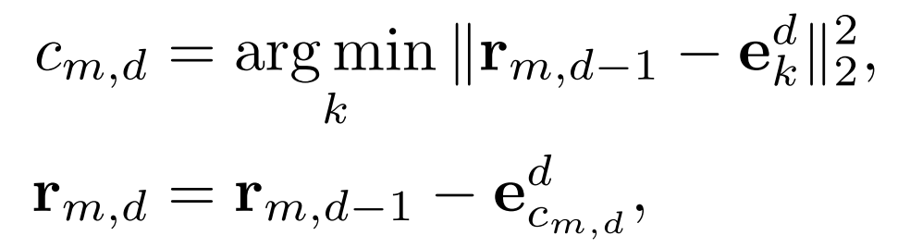
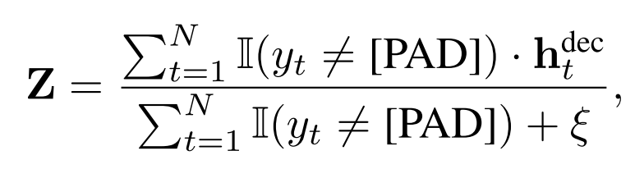
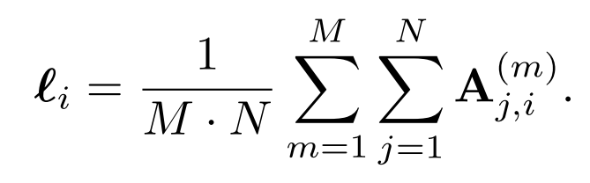
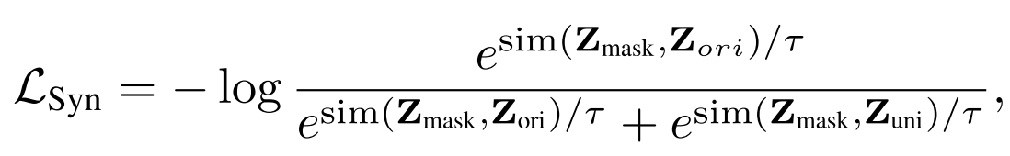
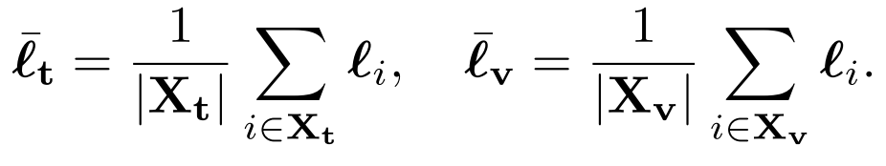
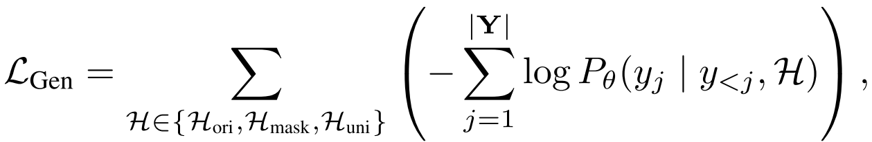
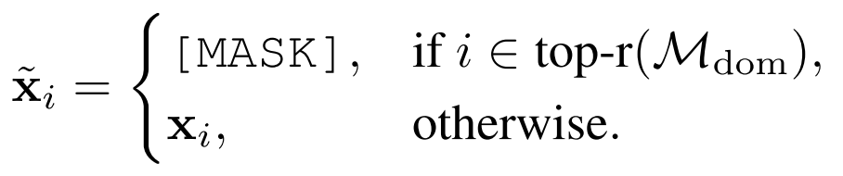
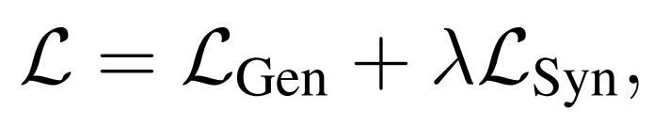
ChongqingUniversity of Technology
ATAI
AdvancedTechniqueof
Artificial Intelligence
ATAI
ChongqingUniversity _{AdvancedTechniqueof}
of Technology Artificial Intelligence
Method
(8)
(12)
(9)
(13)
(10)
(14)
(11)
(15)

Slide 6

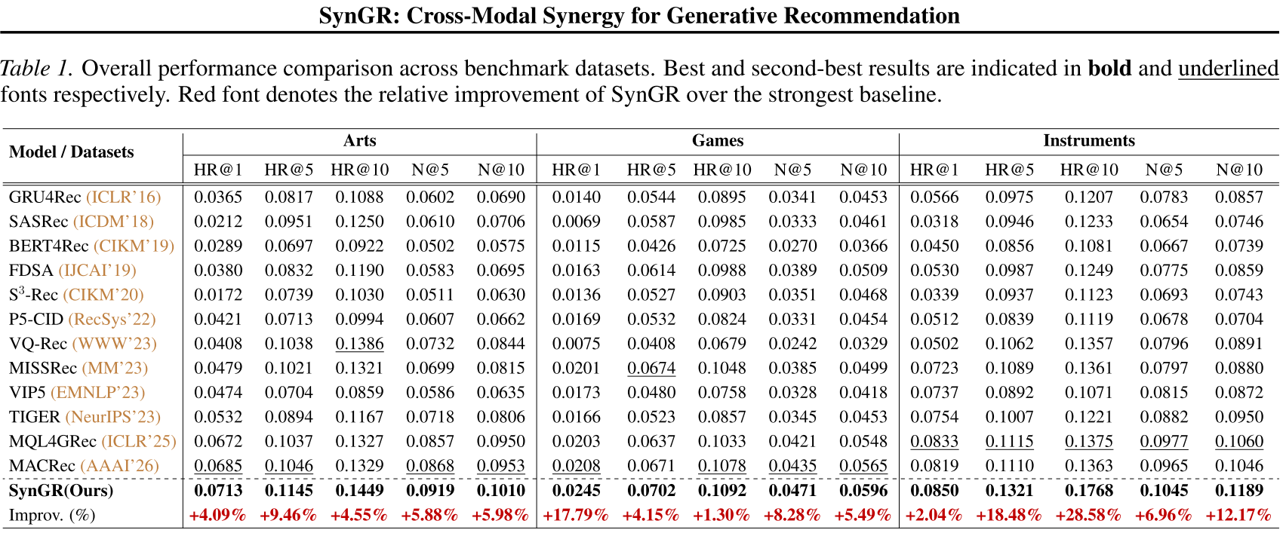
ATAI
AdvancedTechniqueof
Artificial Intelligence
ATAI
ChongqingUniversity _{AdvancedTechniqueof}
of Technology Artificial Intelligence
ChongqingUniversity of Technology
Experiments

Slide 7
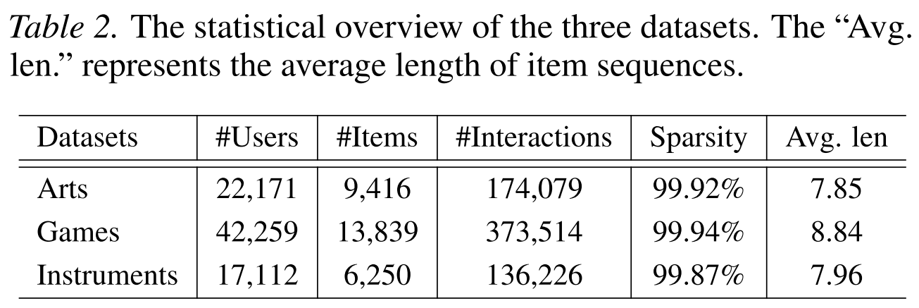
ATAI
AdvancedTechniqueof
Artificial Intelligence
ATAI
ChongqingUniversity _{AdvancedTechniqueof}
of Technology Artificial Intelligence
ChongqingUniversity of Technology
Experiments

Slide 8
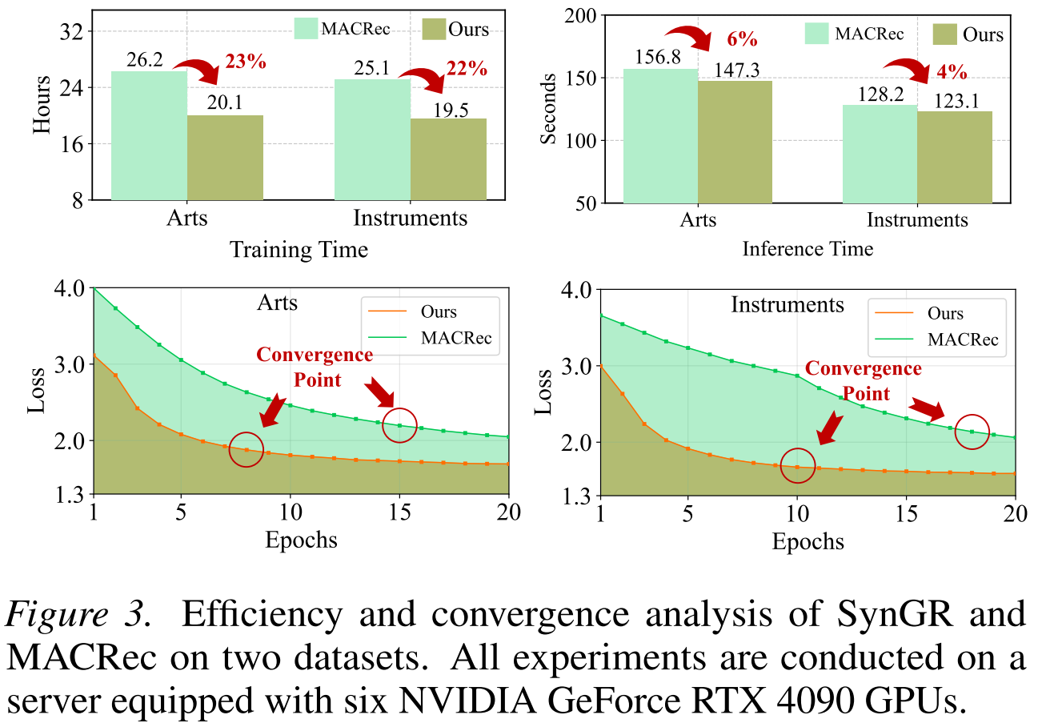
ATAI
AdvancedTechniqueof
Artificial Intelligence
ATAI
ChongqingUniversity _{AdvancedTechniqueof}
of Technology Artificial Intelligence
ChongqingUniversity of Technology
Experiments

Slide 9
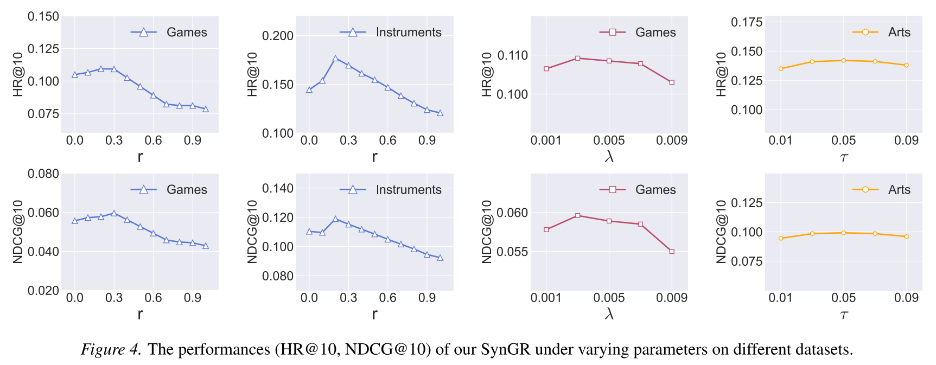
ATAI
AdvancedTechniqueof
Artificial Intelligence
ATAI
ChongqingUniversity _{AdvancedTechniqueof}
of Technology Artificial Intelligence
ChongqingUniversity of Technology
Experiments

Slide 10
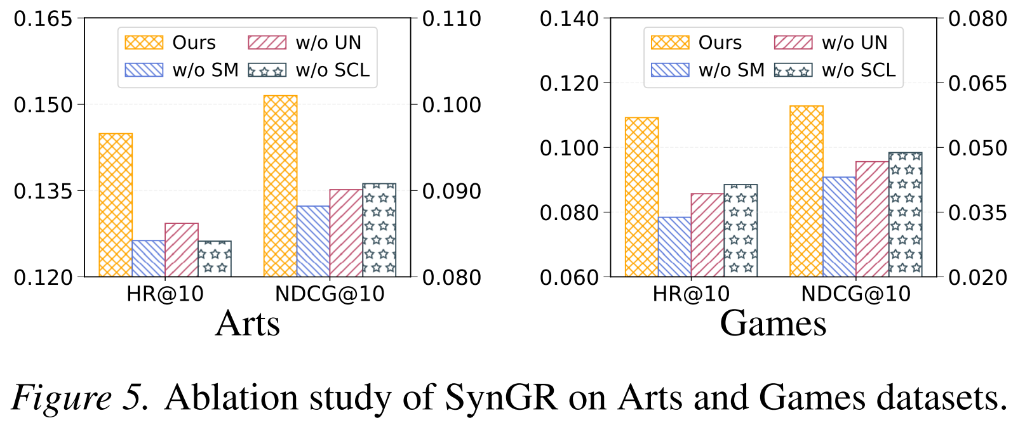
ATAI
AdvancedTechniqueof
Artificial Intelligence
ATAI
ChongqingUniversity _{AdvancedTechniqueof}
of Technology Artificial Intelligence
ChongqingUniversity of Technology
Experiments

Slide 11
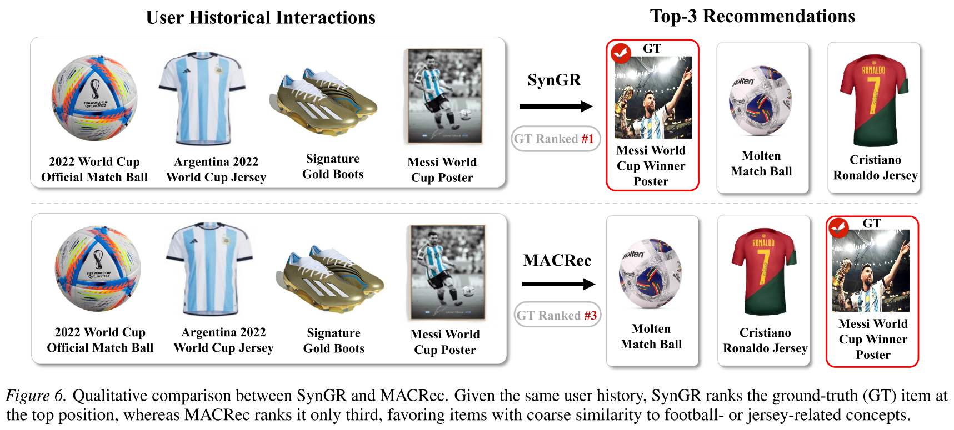
ATAI
AdvancedTechniqueof
Artificial Intelligence
ATAI
ChongqingUniversity _{AdvancedTechniqueof}
of Technology Artificial Intelligence
ChongqingUniversity of Technology
Experiments

Slide 12


ChongqingUniversity of Technology
ATAI
AdvancedTechniqueof
Artificial Intelligence
ATAI
ChongqingUniversity _{AdvancedTechniqueof}
of Technology Artificial Intelligence
Thanks!

